Slide 1
Advanced Image Processing Techniques for Medical Diagnostics in Brain Stroke Prediction.
FINAL VIVA VOICE
Batch Number: 12
Under the Supervision of,
Ms. Bhavya.B
Assistant Professor
School of Computer Science & Engineering
Presidency University
Roll Number | Student Name
20211CIT0052 | ERANTI SAI KISHAN
20211CIT0060 | MEGHANA.GS
20211CIT0049 | LAKKI REDDY VARSHITHA
20211CIT0052 | ERANTI SAI DINESH

Slide 2
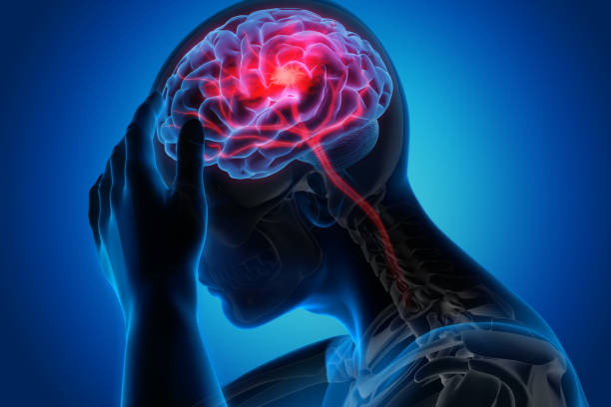
Introduction
A brain stroke also known as a stroke, occurs when the blood supply to a part of the brain is disrupted or reduced, preventing brain tissue from receiving the oxygen and nutrients it needs to function. This can cause brain cells to begin dying within minutes.
Brain stroke detection is a critical process that involves identifying interruptions in blood flow to the brain, which can lead to severe neurological damage or even fatality if not treated promptly. Utilizing advanced technologies such as artificial intelligence, machine learning, and medical imaging, early detection systems can analyze brain scans like CT or MRI to identify patterns indicative of ischemic or hemorrhagic strokes.
Early diagnosis enables timely medical intervention, reducing the risk of permanent disability and improving recovery outcomes. Empowering healthcare systems with stroke detection solutions ensures better patient care and contributes to saving countless lives.

Slide 3
Literature Review
SLNO | TITLE OF THE PAPER AND THE YEAR | AUTHOR | JOURNAL | METHODOLOGY | ADVANTAGE
1 | Stroke Prediction Using Deep Learning and Transfer Learning Approache | Ting-Wei Wu | Taiwan National Science and Technology Council | Category imbalance treatment and deep learning method. | Achieved a 71.6% accuracy and a 19.1% false-negative rate
2 | An Improved Concatenation of Deep Learning Models for Predicting and Interpreting Ischemic Stroke | Nurul Halimatul Asmak Ismail | Deputyship for Research and Innovation, Ministry of Education, Saudi Arabia | a convolutional neural network and a long short-term memory, logistic regression, random forest, extreme gradient boosting, k-nearest neighbor, artificial neural network, long short-term memory, and convolutional neural network | 95.9% accuracy
3 | Automated Ischemic Stroke Subtyping Based on Machine Learning Approach | Gang Fang | National Science Foundation of China | C, Random-Forest-Classifier, Extra-Trees-Classifier, AdaBoost-Classifier, and Multinomial-Naïve-Bayes-Classifier as estimator respectivelY
4 | Automated Stroke Prediction Using Machine Learning: An Explainable and Exploratory Study With a Web Application for Early Intervention | Jungpil Shin | Competitive Research Fund of The University of Aizu, Japan | SHAP (Shapley Additive Explanations) and LIME (Local Interpretable Model-agnostic Explanations) | 83-91% accuracy

Slide 4
Cont..
SLNO | TITLE OF THE PAPER AND THE YEAR | AUTHOR | JOURNAL | METHODOLOGY | ADVANTAGE
5 | A Review on Computer Aided Diagnosis of Acute Brain Stroke | Mahesh Anil Inamdar UdupiRaghavendra Anjan Gudigar Yashas Chakole Ajay Hegde Girish R. Menon Prabal Barua Elizabeth Emma Palmer Kang Hao Cheong Wai Yee Chan Edward J. Ciaccio and U. Rajendra Acharya | MDPI (2021) | Bayesian, SVM (Support Vector Machine), KNN (k-nearest neighbors), MLP(Multi-layer Perceptron) and OPF classifiers, Image texture analysis using GLCC(Graph-Level Contrastive Clustering), ANN(Artificial Neural Network),Decision Tree, Multidirectional features based on Discrete curvelet transform and watershed algorithm for fetching the ROI and then applying support vector machines to develop the classification system, Unsupervised feature learning through RBM with RF classifier, DBSCAN, hierarchical DBSCAN(HDBSCAN) and local outlier factor(LOF) for identification of erroneous stroke detection | Fastest extraction time IACC:99.30% SVMIACC:98% IDC:0.88IACC0.82 IACC99.1% IDC0.81 0.84 DBSCAN(Avg)IACC96.9
6 | Automatic brain ischemic stroke segmentation with deep learning: A review | Hossein Abbasi, Maysam Or0uskhani, Samaneh Asgari, Sara Shomal Zadeh | Neuroscience Informatics (2023) | MRI - Residual ConvLSTM U-Net, SGD-Net, MRI - 3D U-Net CNN + zoom-in & out strategy, CT – 3D U-Net, CT - MultiRes U-Net based CNN | High accuracy, multi-parametric imaging High DSC High DSC, bone imaging, low sensitivity to motion artifacts High DSC, low sensitivity to motion artifacts
7 | Neuroimaging and deep learning for brain stroke detection - A review of recent advancements and future prospects | R. Karthik, R. Menaka, Annie Johnson, Sundar Anand | Computer Methods and Programs in Biomedicine (2020) | Cho et al., 2019 [92] - 135974 images CNN and FCN, Patel et al., 2019 [94]- 1940 CNN and RNN, Kuo et al., 2019 [95] - 4,396 head CT scans FCN | Accuracy: 98.28% Dice Coefficient: 0.84 Accuracy: 87% AUC: 0.96 AUC: 0.991
8 | Current approaches and advances in the imaging of stroke | Pragati Kakkar, Tarun Kakkar, Tufail Patankar and Sikha Saha | Disease Models & Mechanisms (2021)

Slide 5
RESEARCH GAPS
The key research gaps for our project are mentioned below:
Data Imbalance and Diversity
Many existing datasets are imbalanced, with a significantly lower number of stroke cases compared to non-stroke cases. Additionally, datasets often lack diversity in terms of ethnicity, age, and gender, limiting the generalizability of prediction models.
Emerging Risk Factors
Current models focus on traditional risk factors like hypertension, cholesterol, and smoking. Research is lacking in exploring the predictive power of emerging factors such as genetic predispositions, environmental influences, and real-time lifestyle data (e.g., sleep patterns, stress levels).
Integration of Real-Time Data
Few studies integrate real-time data from wearable devices or Internet of Things (IoT) technologies, which could provide continuous monitoring and early warnings for stroke risk.

Slide 6
Proposed Methodology
We have developed an advanced machine learning algorithm that utilizes medical imaging data (CT scans or MRIs) to predict the occurrence and severity of brain strokes. By using effective deep learning model, the project aims to achieve high accuracy and reliability in identifying ischemic or hemorrhagic strokes.
Key Components:
• Preprocessing of medical images (e.g., skull-stripping, normalization).
• Segmentation and classification of brain regions using UNet or 3D CNN.
• Feature extraction using pre-trained models (VGG, EfficientNet). • Final prediction using DenseNet, Transformer-based models.

Slide 7
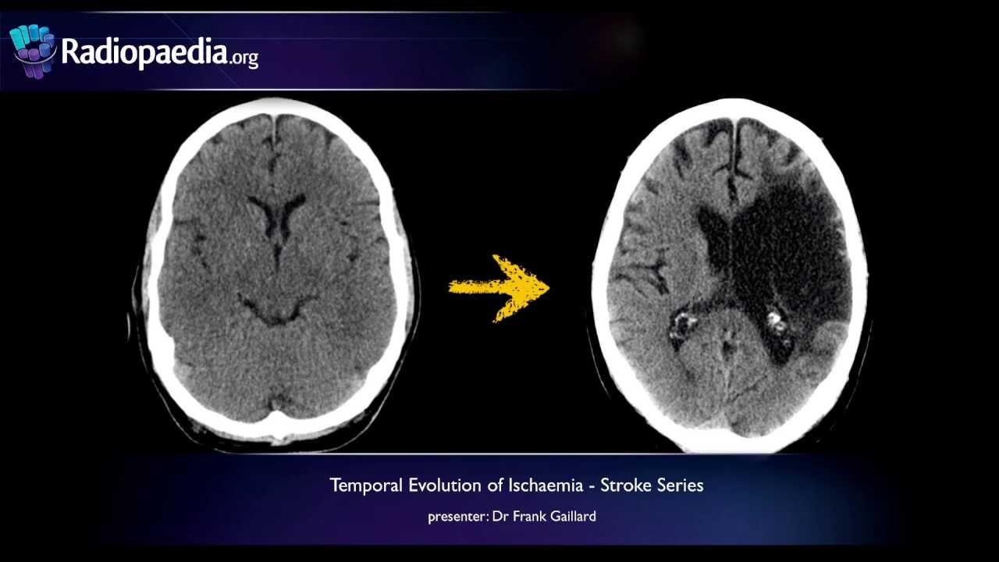
Objectives
The primary objective of the project is to:
Accurately classify medical images as stroke-positive or stroke-negative.
Leverage state-of-the-art architectures to improve the accuracy and computational efficiency of stroke prediction.
Provide explainable AI (XAI) insights using Grad-CAM or SHAP for stroke identification, aiding medical practitioners in decision-making.

Slide 8
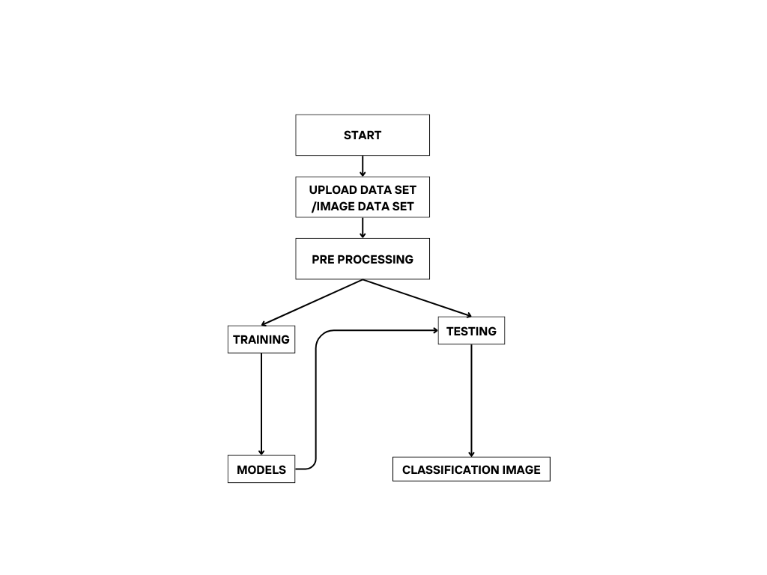
THE ARCHITECTURE DIAGRAM FOR BRAIN STROKE PREDICTION

Slide 9
Timeline of Project
Phase | Tasks | Duration | Timeline
Research | Problem Understanding, Planning | 1 week | UPTO 12-Sep-2024
Data Preprocessing | Data Collection, EDA | 3 weeks | UPTO 18-OCT-2024
Model Development | Image Processing,Modeling | 2 weeks | UPTO 9-NOV-2024
Training & Eval | Model Training, Validation | 2 weeks | UPTO 30-NOV-2024
Web Dev | UI, Backend, Model Integration | 2 weeks | UPTO 17-DEC-2024
Deployment | Cloud Infra, Model Deployment | 1 week | UPTO 24-DEC-2024
Testing | UAT, Feedback, Optimization | 1 week | UPTO 10-JAN-2025
Maintenance | Ongoing System Updates, Security | Ongoing | UPTO 17-JAN-2025

Slide 10
Expected Outcomes
High Accuracy in Stroke Detection
Weather stroke is present or not

Slide 11
Conclusion
This advanced brain stroke prediction system leverages VGG16 and a custom 2D-CNN model to accurately detect and classify strokes from medical imaging data, such as CT and MRI scans. By employing precise segmentation techniques, the system identifies stroke-affected brain regions and differentiates between ischemic and hemorrhagic strokes.
With Stroke Presence Detection, the system determines whether a stroke is present, providing a reliable diagnostic foundation. Through optimized VGG16 and a fine-tuned 2D-CNN, the system achieves high accuracy in both detection and classification tasks.
Explainability is ensured with tools like Grad-CAM, which offer visual insights into model predictions. This transparency enhances clinical reliability and builds trust among medical professionals.
Segmentation and classification are seamlessly integrated. The 2D-CNN model excels in feature extraction, while VGG16 enhances classification performance through its pre-trained architecture, ensuring a robust workflow.
The system effectively distinguishes between ischemic and hemorrhagic strokes, supporting informed and precise treatment decisions. Designed for integration into healthcare workflows, it enables timely and accurate diagnosis, improving patient outcomes and empowering critical decision-making.
By focusing on the strengths of VGG16 and 2D-CNN, this system ensures efficiency and reliability. It serves as a powerful tool for early stroke detection, ultimately enhancing patient care and saving countless lives.

Slide 12
References
IEEE Transactions on Medical Imaging: A leading journal in the field of medical image analysis.
IEEE Journal of Biomedical and Health Informatics: Focuses on the intersection of biomedical engineering and informatics.
IEEE Transactions on Biomedical Engineering: Covers a wide range of topics in biomedical engineering, including medical imaging and signal processing.
IEEE International Conference on Engineering in Medicine and Biology (EMBC): A major annual conference in the field of biomedical engineering.
IEEE Conference on Computer Vision and Pattern Recognition (CVPR): A top-tier conference for computer vision research, including medical image analysis.
Automatic Neuroimage Processing and Analysis in Stroke—A Systematic Review
Current approaches and advances in the imaging of stroke
Neuroimaging and deep learning for brain stroke detection - A review of recent advancements and future prospects
A Review on Computer Aided Diagnosis of Acute Brain Stroke
Automatic brain ischemic stroke segmentation with deep learning: A review

Slide 13
Thank You

